Slide 1

ANNAMACHARYA INSTITUTE OF TECHNOLOGY AND SCIENCES::TIRUPATI (AUTONOMOUS) Computer Science and Engineering A.Y.: 2025-2026 Final Review AN AUTOMATED MACHINE LEARNING APPROACH FOR MOBILE APP RATING ESTIMATION
Head of the Department
Dr T Sreenivasula Reddy., M.Tech., Ph.D
Professor & HOD
Department of CSE
AITS, Tirupati
Under the Guidance of
Ms V Bhargavi., M.Tech
Assistant Professor
Department of CSE
AITS, Tirupati
BATCH NO: 03
22AK1A0537 GEETHANJALI G
22AK1A0541 HARSHITHA K
22AK1A0509 ARSHIYA Y
22AK1A0540 HARSHA VARDHAN REDDY N

Slide 2
ABSTRACT
Mobile applications receive millions of user reviews and ratings every day. Analyzing these ratings helps developers understand user satisfaction. This project focuses on building a machine learning model to forecast mobile app ratings based on historical data, user reviews, and app-related features. The system helps developers improve app quality and user experience. Mobile app ratings play a crucial role in influencing user decisions, developer success, and application visibility.The Machine Learning Model for Forecasting the Rating of Mobile Apps focuses on predicting app ratings using advanced data-driven approaches.
Keywords : Mobile App Ratings | Machine Learning | Sentiment Analysis | NLP | Prediction | Data Analysis | User Satisfaction | Model Accuracy

Slide 3
DOMAIN INTRODUCTION
Data Integration and Processing
Integrates data from multiple sources such as app metadata, numerical ratings, and user reviews, and performs cleaning, normalization, and feature extraction to ensure data quality.
Transforms raw and unstructured data into structured formats suitable for machine learning models, improving efficiency and prediction accuracy.
Machine Learning and Recommendation Techniques
Applies supervised machine learning algorithms to learn patterns from historical app data and forecast future app ratings accurately.
Uses recommendation techniques to suggest relevant mobile applications to users based on predicted ratings and user preferences.
Natural Language Processing (NLP)
Analyzes textual user reviews using sentiment analysis and feature extraction techniques to capture user opinions and emotions.
Converts unstructured review text into numerical representations that enhance rating prediction models when combined with machine learning.

Slide 4
EXISTING SYSTEM
Existing systems rely on basic statistical analysis or manual review monitoring.
Developers analyze average ratings and user feedback manually.
These approaches are time-consuming and do not accurately predict future ratings.
Mobile app ratings play a crucial role in influencing user decisions, developer success, and application visibility.

Slide 5
EXISTING SYSTEM-DISADVANTAGES
Low prediction accuracy.
Manual analysis of app ratings and reviews is time-consuming
No capability to predict future app ratings
Low accuracy due to use of basic statistical methods
User reviews are not fully utilized for sentiment analysis
Difficult to handle large volumes of app data
Lack of real-time analysis and updates
Does not consider user preferences or behavior
Limited support for decision making by developers
Presence of noisy data like fake or spam reviews reduces reliability
Poor scalability with increasing data size

Slide 6
LITERATURE SURVEY
S.No | Title of the Paper | Problem Statement | Method / Algorithm Used | Year | Author(s)
1. | Rating Prediction of Google Play Store Apps with Application of Data Mining Techniques | Traditional methods fail to accurately predict app ratings from large and complex datasets | Data mining techniques, classification and regression models | 2021 | R. Gomes da Silva, J. de Oliveira Liberato Magalhães, I. R. Rodrigues Silva et al.
2. | Analysis and Development of IoT-based Monitoring System | Difficulty in analyzing large-scale data efficiently using conventional approaches | Machine learning models with data preprocessing techniques | 2022 | N. Z. Zamzari, M. Kassim, M. Yusoff

Slide 7
3. | A Study on Performance of Machine Learning Algorithms | Selecting the most accurate ML algorithm for prediction problems | KNN, Random Forest, SVM, Regression algorithms | 2023 | P. Rawat, M. Bajaj, P. Prerna et al.
4. | Prototype of Intelligent Tracking System Using Machine Learning | Inefficient prediction and tracking due to lack of intelligent models | Feature extraction and supervised machine learning | 2021 | O. Khattab, A. Almetlaqem, D. Almutairi et al.

Slide 8
PROPOSED SYSTEM
The paper proposes a machine learning approach for forecasting app ratings on the Google Play Store. Key aspects include:
Classification of data according to Google Play apps to improve accuracy.
Handling of large datasets with semi-structured or unstructured data.
Vectorial representation of textual data for machine learning.
Use of regression techniques, specifically KNN (K-Nearest Neighbors) and Random Forest.
Performance evaluation using metrics like accuracy, MAE (Mean Absolute Error), RMSE (Root Mean Square Error), and R2-Score.

Slide 9
PROPOSED SYSTEM-ADVANTAGES
Classifying Google Play apps by category improves the accuracy of app rating prediction.
The system efficiently handles large datasets containing semi-structured and unstructured data.
Vectorial representation of textual reviews enhances the learning capability of machine learning model
Use of KNN and Random Forest with MAE, RMSE, and R² metrics ensures reliable and accurate performance evaluation.

Slide 10
MINIMUM SYSTEM REQUIREMENTS
Software Requirements:
Application platform : Python 3.0 & above
Operating system : Windows 7 & above
Coding Language : Python
Tool : Visual Studio Code
Hardware Requirements:
System : Intel Core i5 or above
Hard Disk : 1TB
Input Devices : Keyboard, Mouse
Ram : 4GB or 8GB

Slide 11
ANALYSIS AND DESIGN

Slide 12
ANALYSIS
The Following Modules are Identified In this Project
1.System Modules 2.User Modules
SYSTEM MODULES
System Modules
Data Collection Module
* Collects app data such as ratings, reviews, installs, app size, category, pricing, and update history.
* Gathers data from sources like Google Play Store and Apple App Store.
* Ensures large and diverse datasets for better model accuracy.
* Integrates multiple data sources for comprehensive analysis.
Data Preprocessing Module
* Handles missing values and removes duplicate entries.
* Cleans noisy data such as fake or irrelevant reviews.
* Converts categorical data into numerical format using encoding techniques.
* Normalizes and scales numerical features to improve model efficiency.

Slide 13
Feature Extraction & Selection Module
* Extracts important features like number of reviews, average rating, app size, and update frequency
* Applies sentiment analysis on user reviews to derive sentiment scores
* Identifies key factors that influence app ratings
* Selects the most relevant features to improve prediction performance
Machine Learning Model Module
* Implements algorithms such as Random Forest, KNN, and Linear Regression
* Trains models using historical app data to learn patterns
* Evaluates models using metrics like accuracy, MSE, and R-squared
* Compares different models to choose the best one
* Predicts future app ratings based on selected features
* Supports data-driven decisions for developers to enhance app quality

Slide 14
USER MODULES
1. User Registration & Authentication Module
This module is responsible for managing user access to the system. New users can create an account by providing basic details such as username, email ID, and password. The authentication process ensures that only authorized users can log in and use the application. Secure login mechanisms help protect user data and maintain privacy while accessing prediction services.
2. App Data Input Module
This module allows users to enter or select mobile app details required for rating prediction. Users can provide information such as app category, number of downloads, size, version, and update frequency. The module validates the input data and forwards it to the system for preprocessing, ensuring accurate and meaningful predictions.
3. Prediction Request Module
The prediction request module enables users to initiate the rating forecasting process. Once app details are submitted, users can request the system to predict future app ratings. This module interacts with the trained machine learning model and sends user requests to the prediction engine for processing.

Slide 15
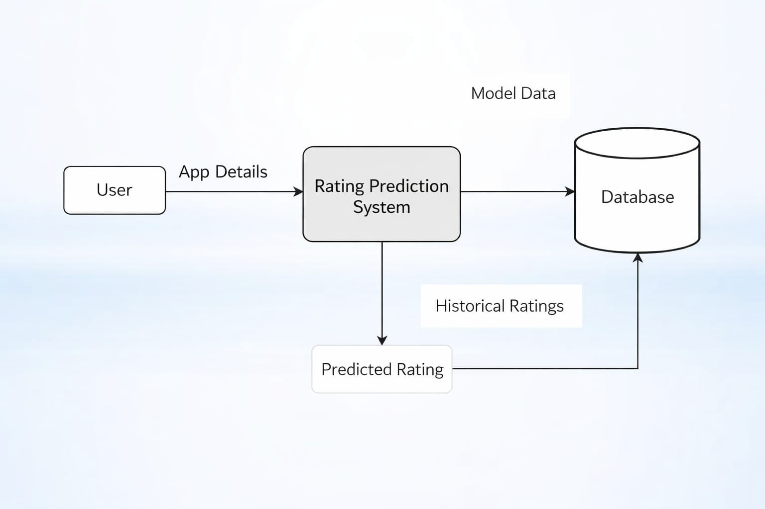
DESIGN DATAFLOW DIAGRAMS
LEVEL 0 :
Shows the overall system as a single process.
Input: app data such as ratings, reviews, installs, and app details.
Output: predicted app ratings.
External entities include data sources like Google Play Store and Apple App Store, and users/developers.

Slide 16
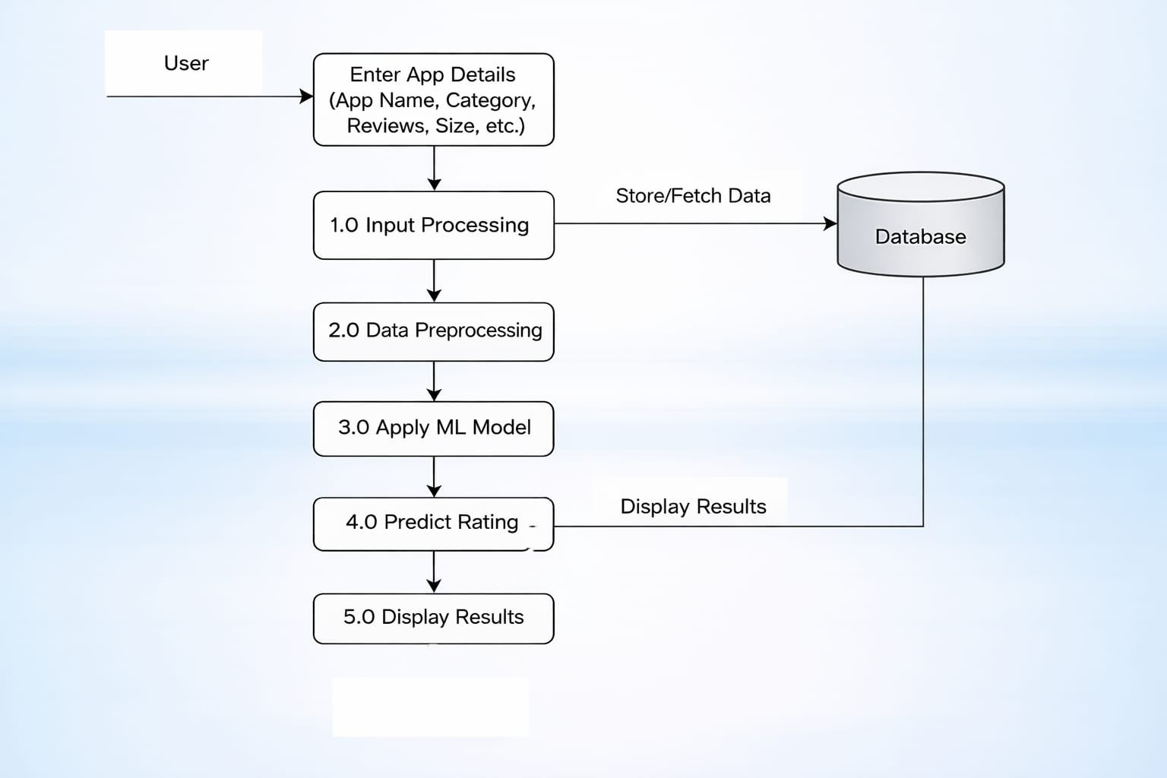
LEVEL 1:
Breaks the system into major modules.
Data Collection process gathers raw app data from APIs/datasets.
Data Preprocessing process cleans and transforms the collected data.
Feature Extraction process selects important attributes influencing ratings.

Slide 17
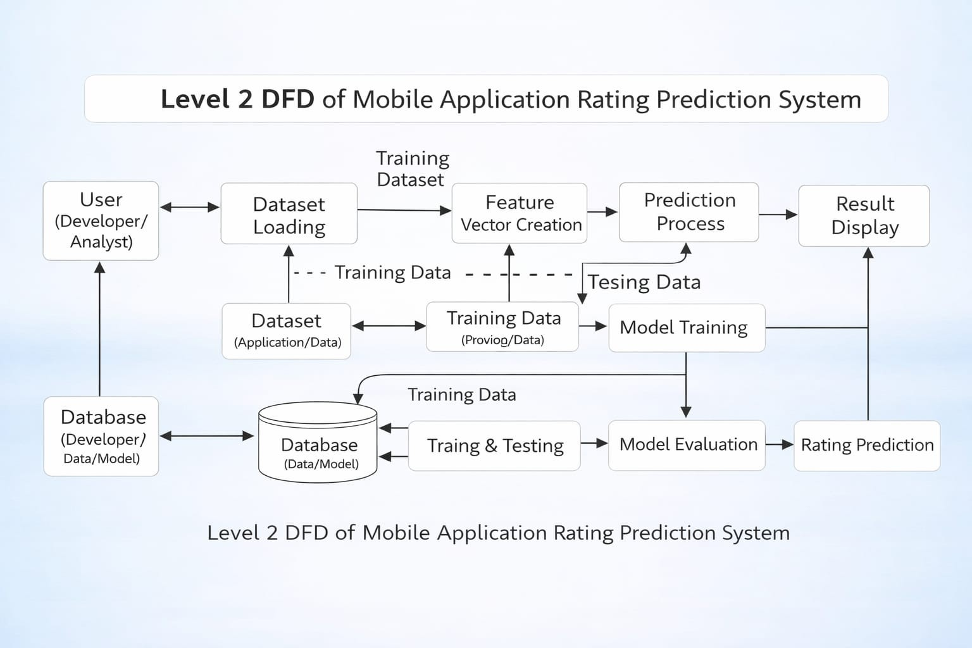
LEVEL 2:
Data Collection: fetches structured and unstructured data (reviews, ratings)
Preprocessing: removes missing values, duplicates, and noise
Feature Engineering: performs sentiment analysis and feature selection
Model Training: applies algorithms like Random Forest, KNN, Regression
Evaluation: checks model performance using metrics
Prediction: generates final rating forecast

Slide 18
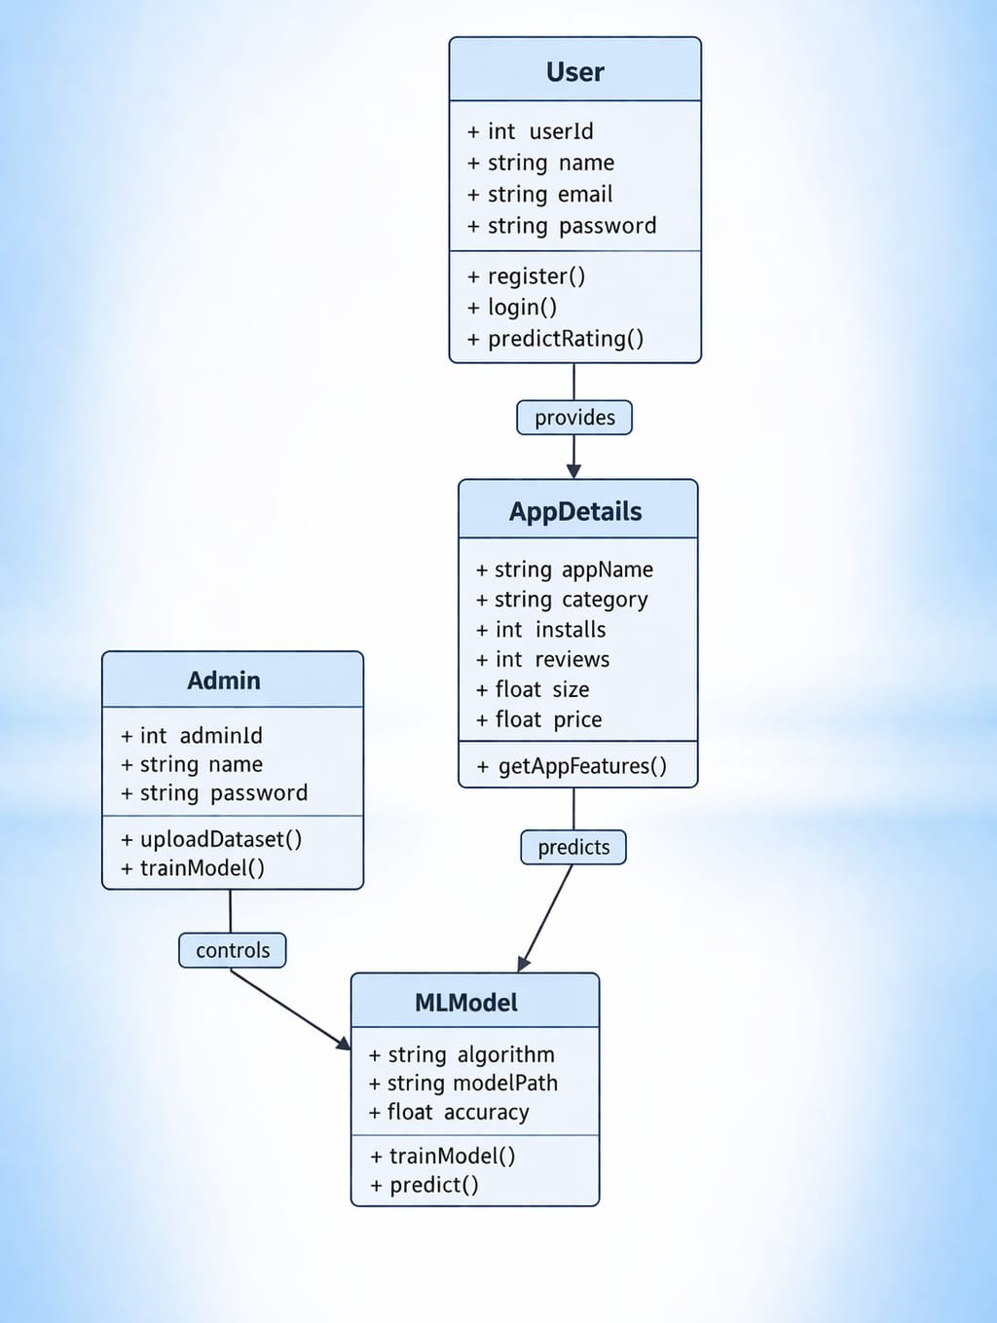
UML DIAGRAMS
CLASS DIAGRAM
User class : Handles registration, login, and rating prediction by providing app details such as name, category, installs, reviews, size, and price.
AppDetails class : Stores all app-related features and sends this data to the ML model for prediction.
MLModel class : Performs training and prediction using selected algorithms and outputs the forecasted app rating.
Admin class : Manages the system by uploading datasets and training the model, while controlling the MLModel operations.

Slide 19
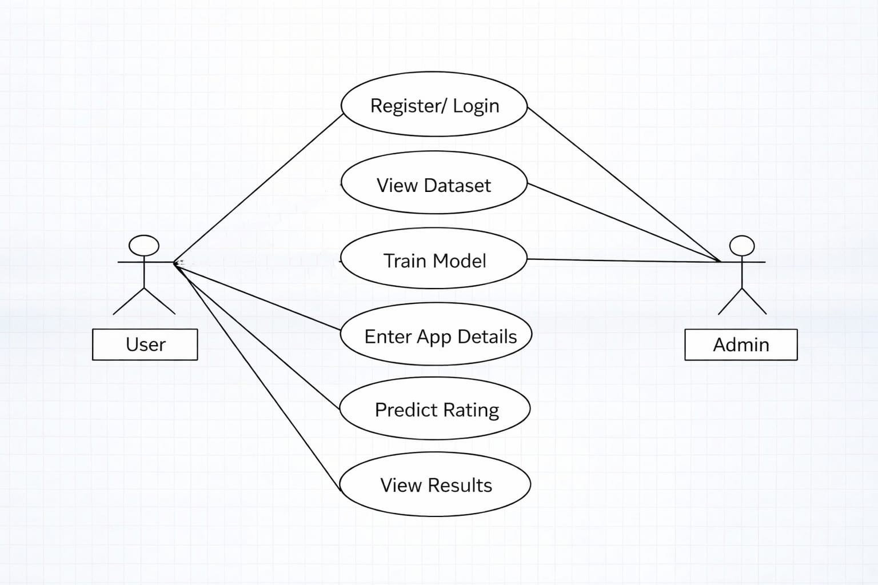
USECASE DIAGRAM
User provides app details such as reviews, ratings, and app features to the system.
The system cleans, processes, and prepares the input data for analysis.
The machine learning model analyzes the data and predicts the app rating.
The system displays the predicted rating and insights to the user.

Slide 20
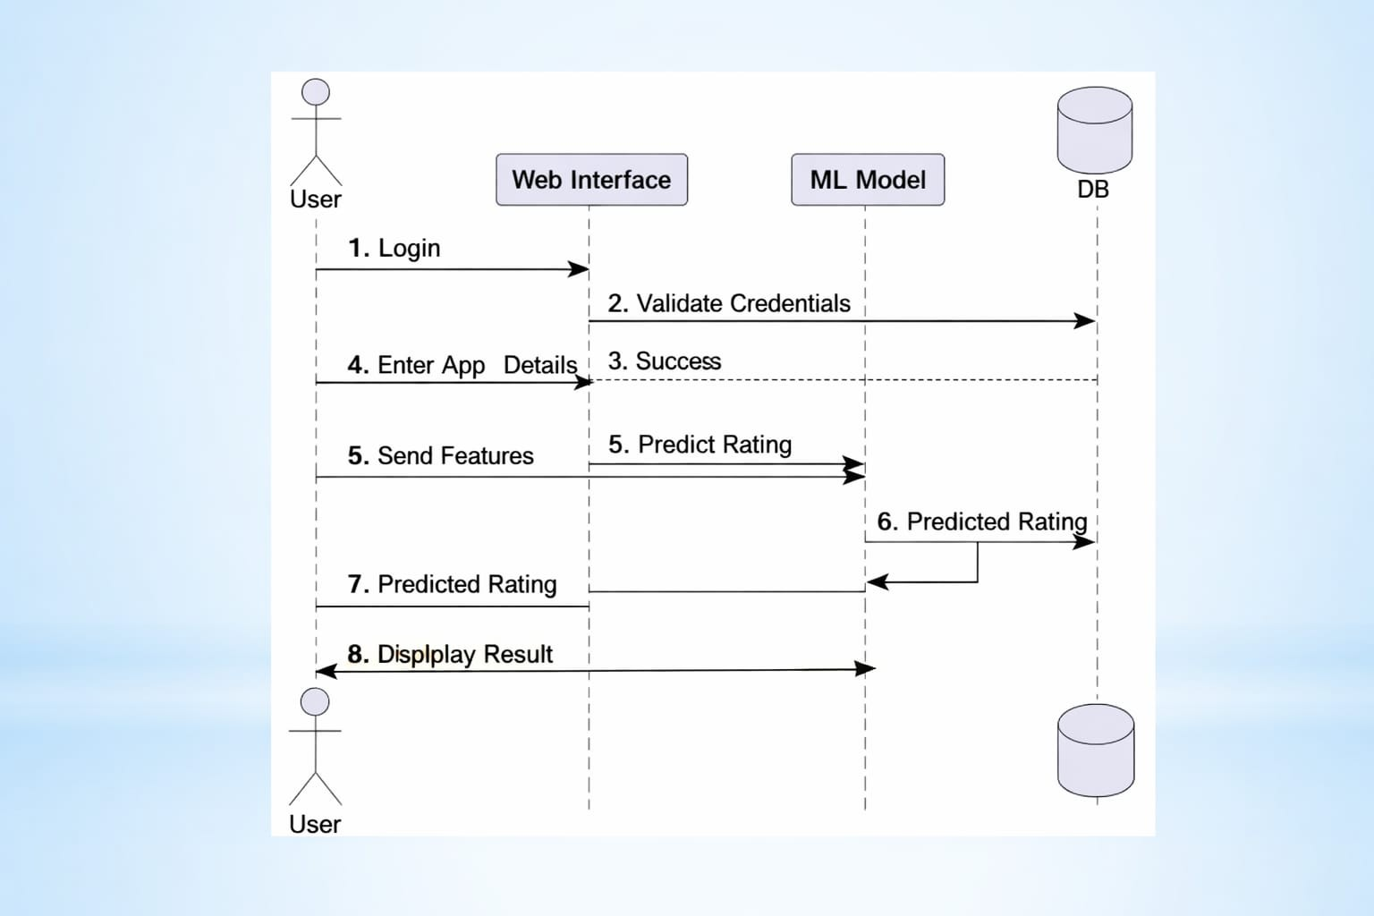
SEQUENCE DIAGRAM
User logs into the system through the web interface, and credentials are validated using the database.
After successful login, the user enters app details, which are processed and sent as input features.
The web interface forwards these features to the machine learning model to predict the app rating.
The predicted rating is returned from the model, stored if needed, and displayed to the user as the final result.

Slide 21
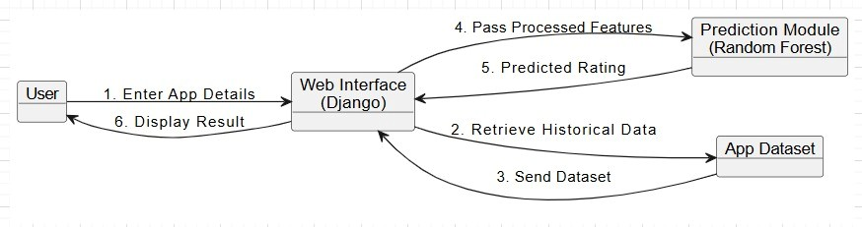
COLLABORATION DIAGRAM
User interacts with the web interface (Django) by entering app details, which initiates the prediction process.
The web interface collaborates with the app dataset to retrieve and send historical data required for analysis.
Processed features are passed from the web interface to the prediction module (Random Forest model) for rating prediction.
The predicted rating is returned to the web interface and then displayed to the user as the final output.

Slide 22
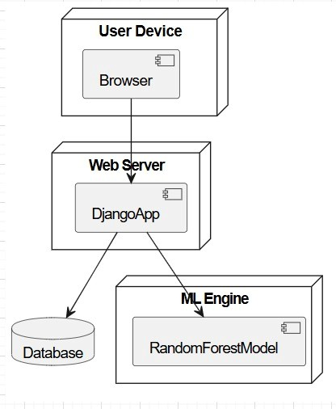
DEPLOYMENT DIAGRAM
User interacts with the system through a browser on the user device to enter app details and request rating prediction.
The request is sent to the web server where the Django application processes inputs and manages system operations.
The Django app communicates with the database to store and retrieve app data and historical information.
The web server connects with the ML engine(Random Forest model) to generate predicted ratings, which are sent back and displayed to the user.

Slide 23
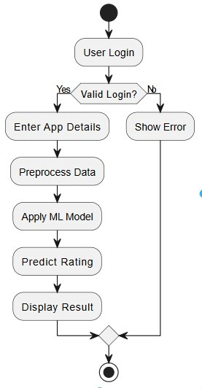
ACTIVITY DIAGRAM
User logs into the system if credentials are valid, the process continues, otherwise an error message is displayed.
After successful login, the user enters app details, and the system performs data preprocessing.
The processed data is given to the machine learning model to analyze and predict the app rating.
The predicted rating is generated and displayed to the user as the final output.

Slide 24
(IMPLEMENTATION, TESTING & RESULTS)

Slide 25
IMPLEMENTATION

Slide 26
The key functions involved in the implementation of the Mobile App Rating Estimation System are:
1. Data Input Function :
Allows the system to collect mobile app data such as app name, category, number of downloads, user reviews, size, and price.
2. Data Preprocessing Function:
Cleans and prepares the collected data by handling missing values, removing duplicates, and converting categorical data into numerical format.
3. Model Training Function:
Uses the processed dataset to train the machine learning model so it can learn the relationship between app features and ratings.
4. Prediction Function:
Takes new app details as input and uses the trained model to estimate the expected rating of the mobile application.

Slide 27
# Required Libraries
from django.shortcuts import render, redirect
from django.contrib import messages
from Users.forms import UserRegisterForm
from Users.models import UserRegisterModel
import pandas as pd
import joblib
from sklearn.model_selection import train_test_split
from sklearn.preprocessing import LabelEncoder
from sklearn.ensemble import RandomForestRegressor
from sklearn.metrics import mean_absolute_error, mean_squared_error
# User Registration System
def UserRegister(request):
if request.method == 'POST':
form = UserRegisterForm(request.POST)
if form.is_valid():
form.save()
return redirect('Userlogin')
else:
form = UserRegisterForm()
return render(request, 'Userregister.html', {'form': form})

Slide 28
# Machine Learning Model Architecture
def train_model():
df = pd.read_csv("media/googleplaystore.csv")
df.dropna(inplace=True)
le = LabelEncoder()
df['Category'] = le.fit_transform(df['Category'])
X = df[['Reviews', 'Installs']]
y = df['Rating']
X_train, X_test, y_train, y_test = train_test_split(X, y, test_size=0.2)
model = RandomForestRegressor()
model.fit(X_train, y_train)
pred = model.predict(X_test)
mae = mean_absolute_error(y_test, pred)
mse = mean_squared_error(y_test, pred)
joblib.dump(model, "media/rf_model.pkl")
return mae, mse
# App Rating Prediction
def Prediction(request):
if request.method == 'POST':
reviews = int(request.POST['reviews'])
installs = int(request.POST['installs'])
model = joblib.load("media/rf_model.pkl")
result = model.predict([[reviews, installs]])
return render(request, 'users/predication.html', {
'prediction': round(result[0], 2)
})
return render(request, 'users/predication.html')

Slide 29
# Training View
deftraining(request):
mae,mse=train_model()
returnrender(request,'users/training.html',{'mae':mae,'mse':mse})
# Prediction
defPrediction(request):
ifrequest.method=='POST':
reviews=int(request.POST['reviews'])
installs=int(request.POST['installs'])
model=joblib.load("media/rf_model.pkl")
result=model.predict([[reviews,installs]])
returnrender(request,'users/predication.html',{'prediction':round(result[0],2)})
returnrender(request,'users/predication.html')
#System Flow
User
↓
Login & Input Data
↓
Data Preprocessing
↓
ML Model
↓
Predicted Rating

Slide 30
TESTING

Slide 31
Testing is the process of evaluating a software system to ensure it works correctly and produces accurate results. In this project, testing mainly involves Functional Testing, White Box Testing, Black Box Testing, User Acceptance Testing, and Integration Testing.
Functional Testing
Functional testing verifies whether the system functions work correctly according to requirements.
In this project it includes:
User registration and login
Dataset loading functionality
Model training process
App details input (reviews, installs)
App rating prediction
Display of predicted rating result
Black Box Testing
In this project, black box testing is used to verify whether the system works correctly when a user interacts with it.
Example in this project:
Entering app details like reviews and installs
Checking if the system predicts the rating correctly
Verifying whether the predicted result is displayed to the user

Slide 32
Example Test Cases
Test Case | Input | Expected Output
User Registration | User details | Account created successfully
User Login | Username & Password | User logged in successfully
Dataset Loading | CSV file | Data displayed correctly
Model Training | Training dataset | Model trained with accuracy values
Rating Prediction | Reviews & Installs | Predicted rating generated
Result Display | Prediction result | Rating displayed to user
White Box Testing
White box testing focuses on testing the internal logic and code structure of the system.
Verifies data preprocessing functions like handling missing values and encoding.
Checks correctness of model training logic and algorithm implementation.
Validates input-output flow inside functions.
Ensures proper working of conditions, loops, and error handling.
Tests integration of dataset with machine learning model.

Slide 33
Integration Testing
Integration testing ensures that different modules of the system work together correctly.
Checks connection between frontend (user interface) and backend (Django)
Verifies data flow from dataset → preprocessing → model → prediction
Ensures model loading and prediction modules work properly together
Tests interaction between database and application.
Confirms that all modules function as a complete system.
User Acceptance Testing (UAT)
User Acceptance Testing ensures the system meets user requirements and is ready for real-world use.
Users test the system by entering app details and checking predictions.
Verifies whether the predicted rating is understandable and useful.
Ensures system is user-friendly and easy to navigate.
Checks overall performance and response time.
Confirms the system satisfies project objectives and user expectations.

Slide 34
RESULTS

Slide 35
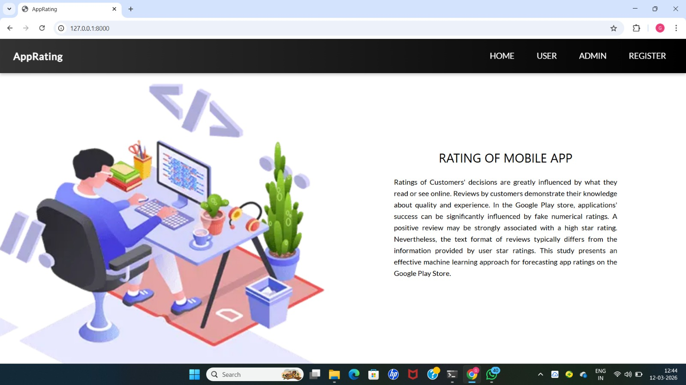
Screen 1: Home screen Page

Slide 36
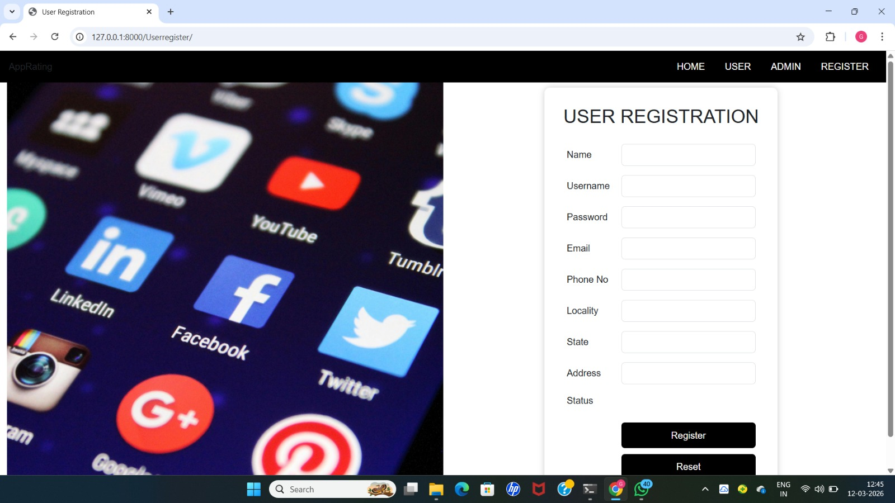
Screen 2: User Registration form

Slide 37
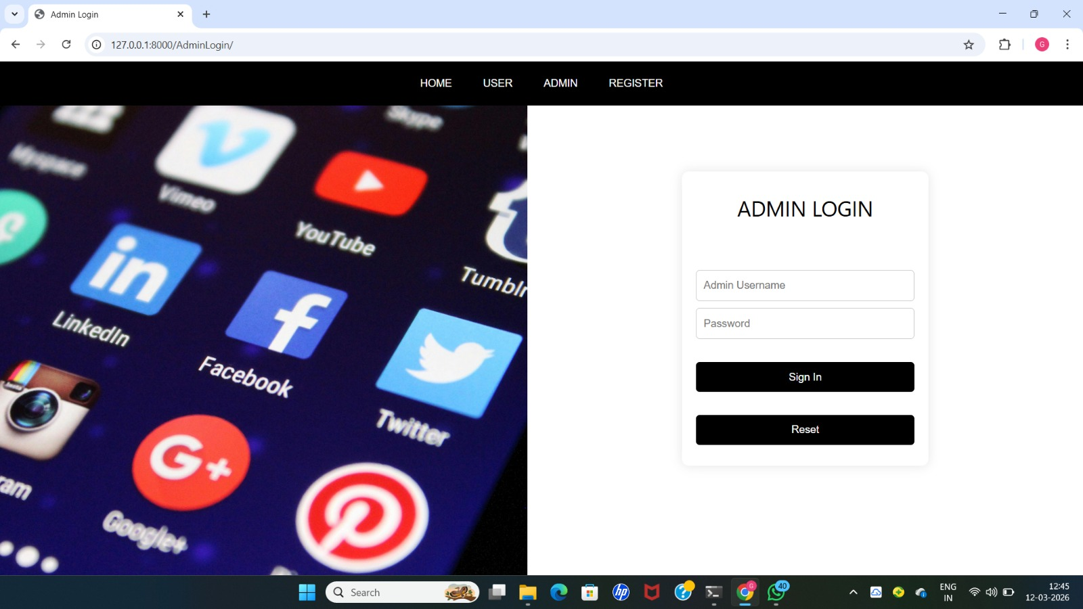
Screen 3:Admin Login Form

Slide 38
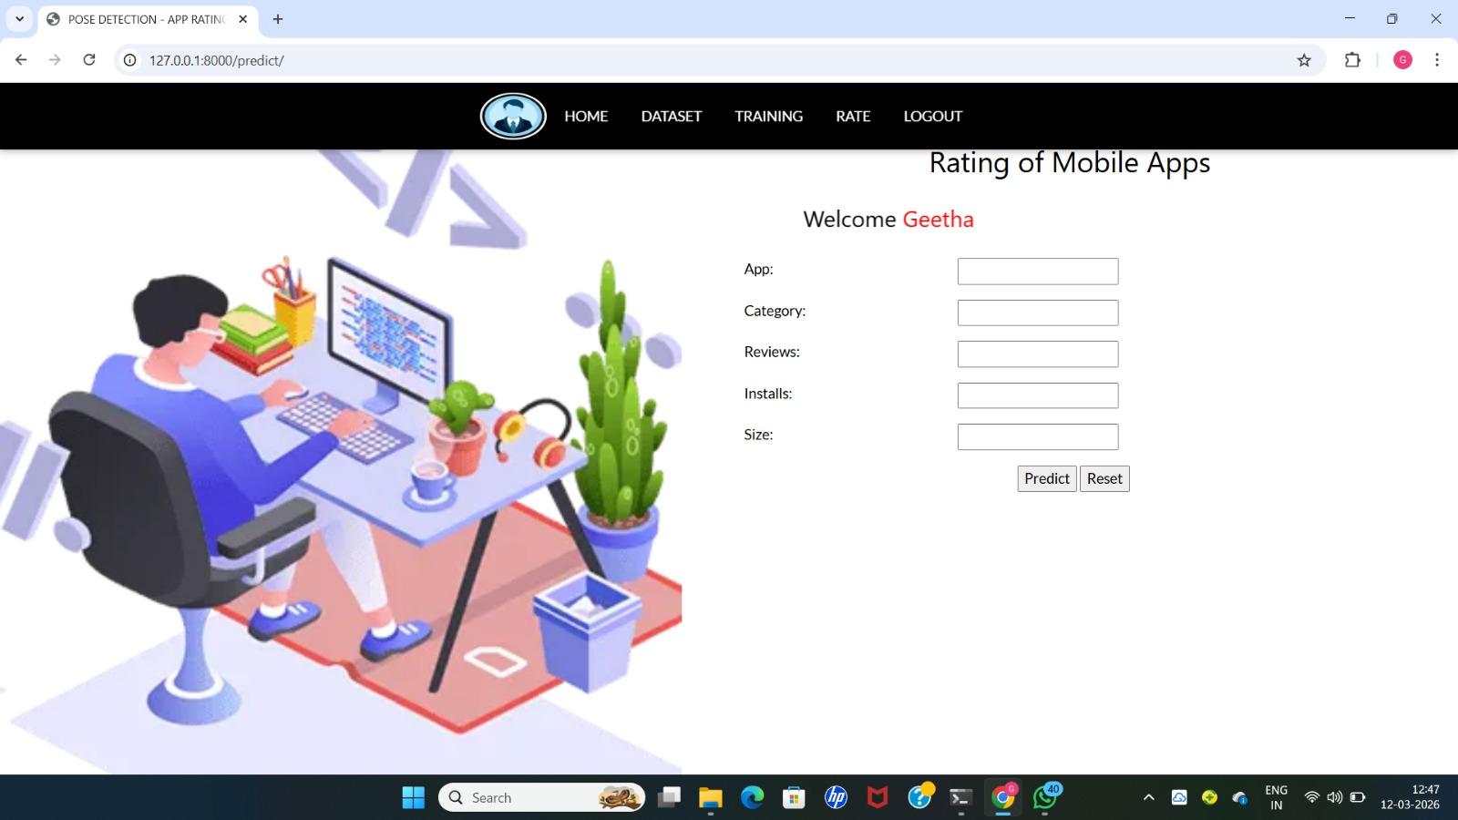
Screen 4 :Image Prediction Page

Slide 39
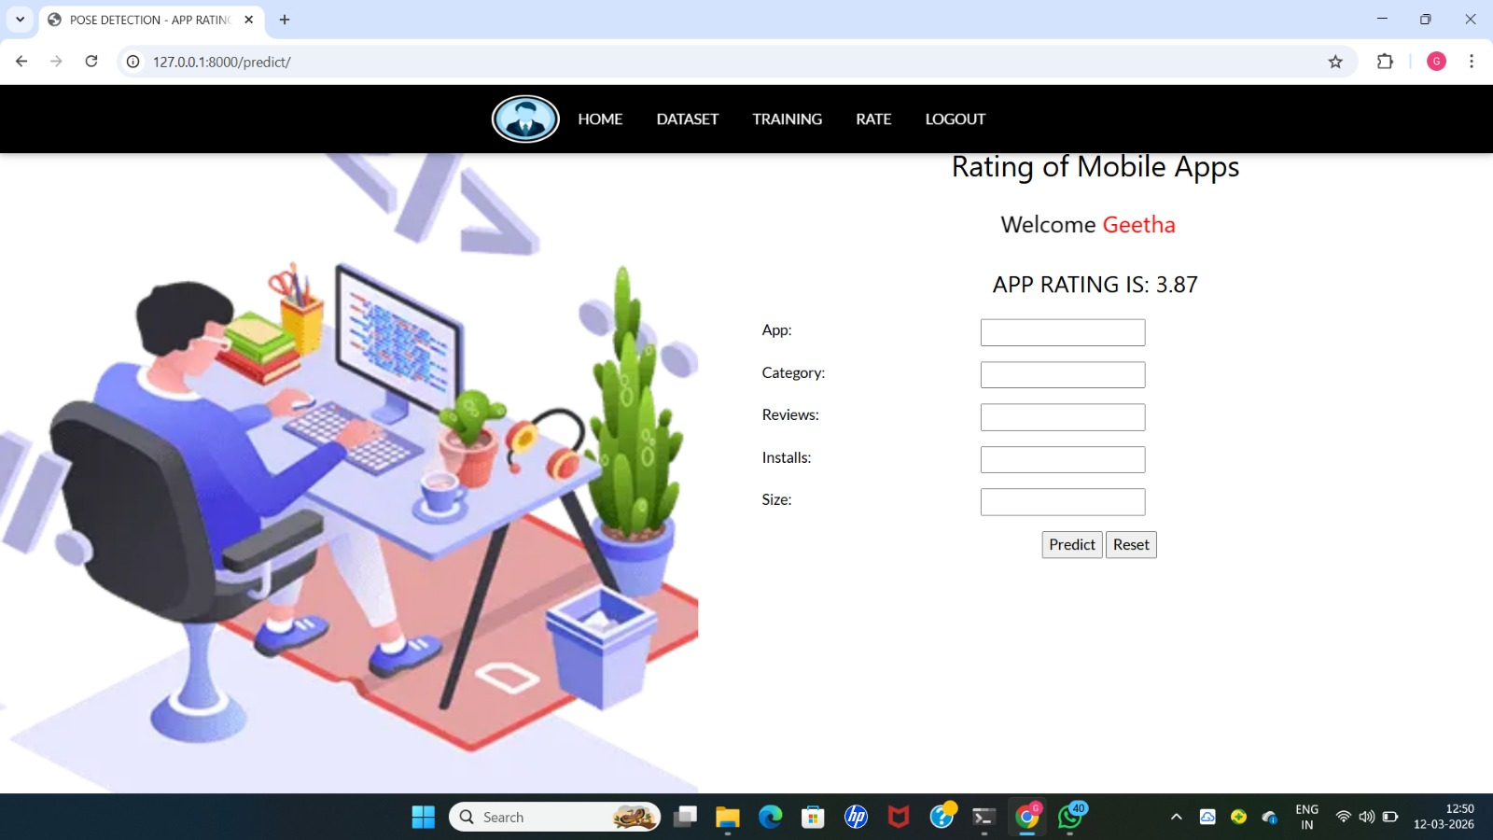
Screen 5 : Prediction Output

Slide 40
CONCLUSION
The automated machine learning approach for mobile app rating estimation helps predict app ratings based on various features such as downloads, reviews, category, and size. By using machine learning algorithms, the system can analyze large amounts of app data efficiently. This approach improves accuracy in estimating ratings and helps developers understand factors influencing user feedback. It also supports better decision-making for improving app quality and user experience. Overall, the system provides a useful tool for predicting app performance in the competitive mobile application market.

Slide 41
REFERENCES
R. Gomes da Silva, J. de Oliveira Liberato Magalhães, I. R. Rodrigues Silva, R. Fagundes, E. Lima and A. Maciel, "Rating Prediction of Google Play Store apps with application of data mining techniques," in IEEE Latin America Transactions, vol. 19, no. 01, pp. 26-32, January 2021, doi: 10.1109/TLA.2021.9423823.
Khattab O., Almetlaqem A., Almutairi D., Alnaser M., Almutairi M. "Prototype of new reliable airport luggage tracker system" International Journal of Emerging Technology and Advanced Engineering, Vol 11 Issue 8, pp. 42 - 47 Aug 2021, DOI: 10.46338/IJETAE0821_06
Zamzari N.Z., Kassim M., Yusoff M. "Analysis and Development of IoT-based Aqua Fish Monitoring System" International Journal of Emerging Technology and Advanced Engineering, Vol. 12 Issue 10,
pp. 191 - 197, Oct 2022, DOI: 10.46338/ijetae1022_20
4. Kcomt-Ponce E.J., Huamaní E.L., Delgado A."Implementation of Machine Learning in Health Management to
Improve the Process of Medical Appointmentsin Perú" International Journal of Emerging Technology and
Advanced Engineering, Vol. 12, Issue 2, pp. 74 - 85 Feb 2022, DOI: 10.46338/ijetae0222_09.
5. P. Rawat, M. Bajaj, P. Prerna, S. Vats, V. Sharma and P. Das, "A Study on Liver Disease Using Different
Machine Learning Algorithms," 2023 International Conference on Computational Intelligence, Communication
Technology and Networking (CICTN), Ghaziabad, India, 2023, pp. 721-727, doi: .
10.1109/CICTN57981.2023.10141325

Slide 42
Thank You
Any Questions

